Slide 1
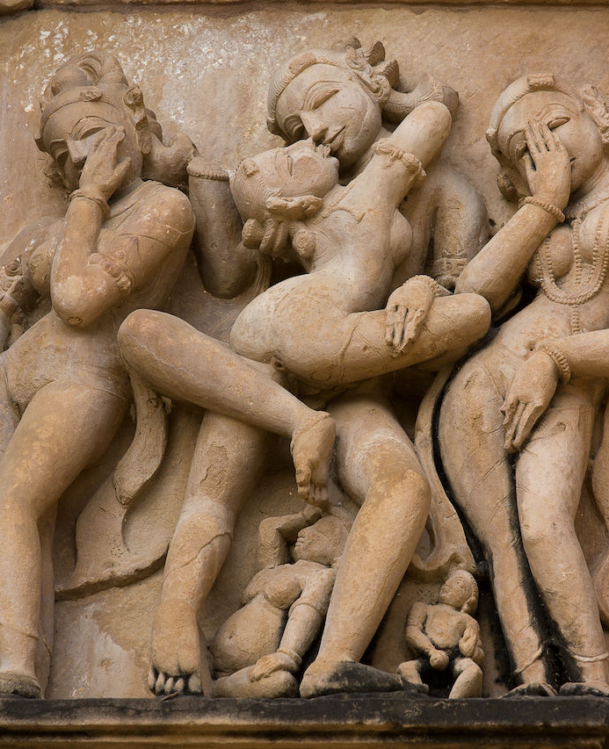
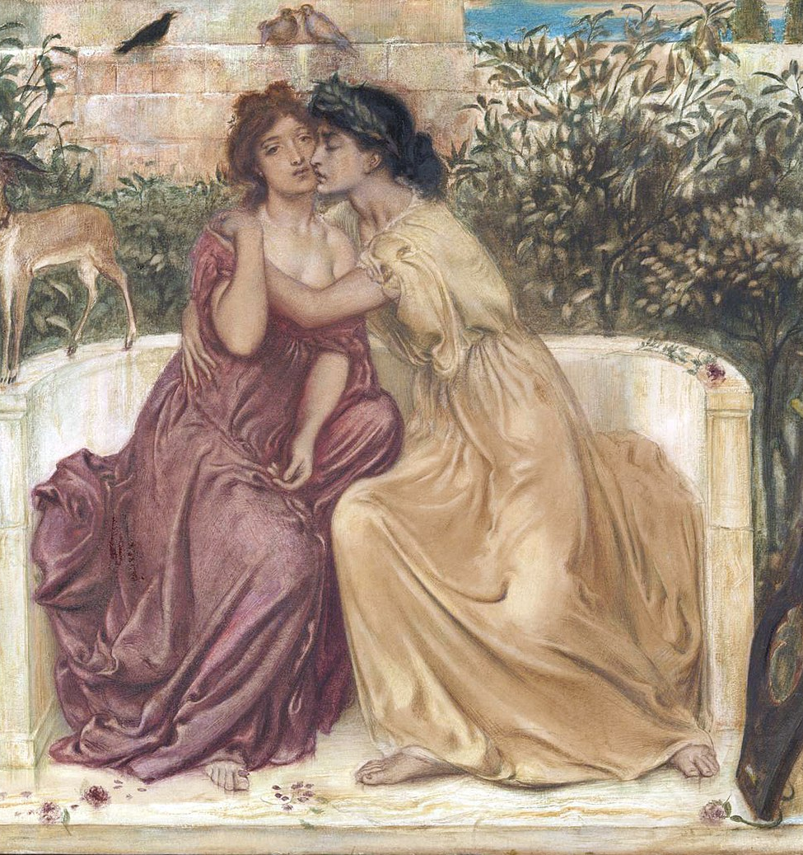

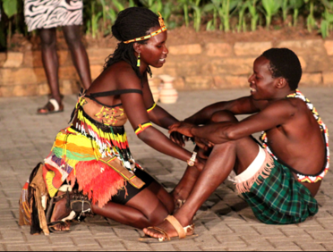
Sexual Behavior Across Cultures
CHAPTER 7

Slide 2


What is Having Sex?
The lawsuit against then-U.S. President Bill Clinton, alleging sexual harassment, showed the impact of sexual behavior in politics:
  Proved that sexual activity could be defined in many different and varied ways.
Sex does not have to include a partner and can include:
  Fantasy
  Masturbation
  Any activity performed with a partner or partners that is related to sexual stimulation, arousal, enjoyment, or reproduction
  Contact which is unlikely to lead to orgasm
  Activities that may potentially lead to orgasm

Slide 3

Sexual Behavior Across Species
Purposes of sexual behavior:
  Recreation
  Procreation
  Affiliation
  Pleasure
  In some species of insects, as a food source
Sexual cannibalism: behavior in some species of insects and arthropods in which one sex, usually the female, eats the other sex during or after mating.
Intraspecies aggression relating to sexual reproduction takes the form of infanticide or fratricide.
Other species that engage in sexual behavior for affiliative purposes:
  Dolphins
  Bonobo chimpanzees

Slide 4

Dreams
Dreams: byproduct of the brain forming and reforming neural connections, and consolidating life’s experiences.
Nocturnal orgasm: orgasm while sleeping.
Sexsomnia: people engaging in sexual activity while they sleep:
  Masturbation or attempting to have sex with a partner.
Lucid dreaming: people being aware they are dreaming as the dream unfolds.

Slide 5


Orgasms During Exercise
Coregasms: physical exercise that stimulates the core muscles groups of the lower pelvic region.
Exercises associated with orgasm includes:
  Yoga
  Cycling
  Weight lifting
  Running
  Walking

Slide 6

Fantasy
Erotic fantasy: waking thoughts about sex.
  Has multiple functions:
    Heightens orgasm
    Used to modulate the timing of an orgasm
    Helpful for individuals who find it difficult to achieve an orgasm
    Used to delay orgasm

Slide 7
Cumulative Sexual Fantasies in College Students

Slide 8
Cumulative Sexual Fantasies in College Students (continued)

Slide 9

Research Focus
  Bivona and Critelli, 2009:
    Higher prevalence for rape fantasies in college females at the University of North Texas:
      62% of females reporting ever having had such a fantasy.
      14% reporting having had rape fantasies at least once a week.
      Does not mean these females want to be sexually assaulted, but such fantasies can be incorporated into consensual sexual activity.

Slide 10
Fantasy
Sexual fantasies may be influenced by:
  Cultural inputs:
    Results in the prevalence of specific fantasies being different in different cultures.
    Exposure to erotic materials as one develops.
  Differences in individual experience.
  Random developmental events.
Fantasy involving the potential of harm or dysfunction:
  Can involve fantasies of illegal activity.
  May help a person avoid actual harm.

Slide 11
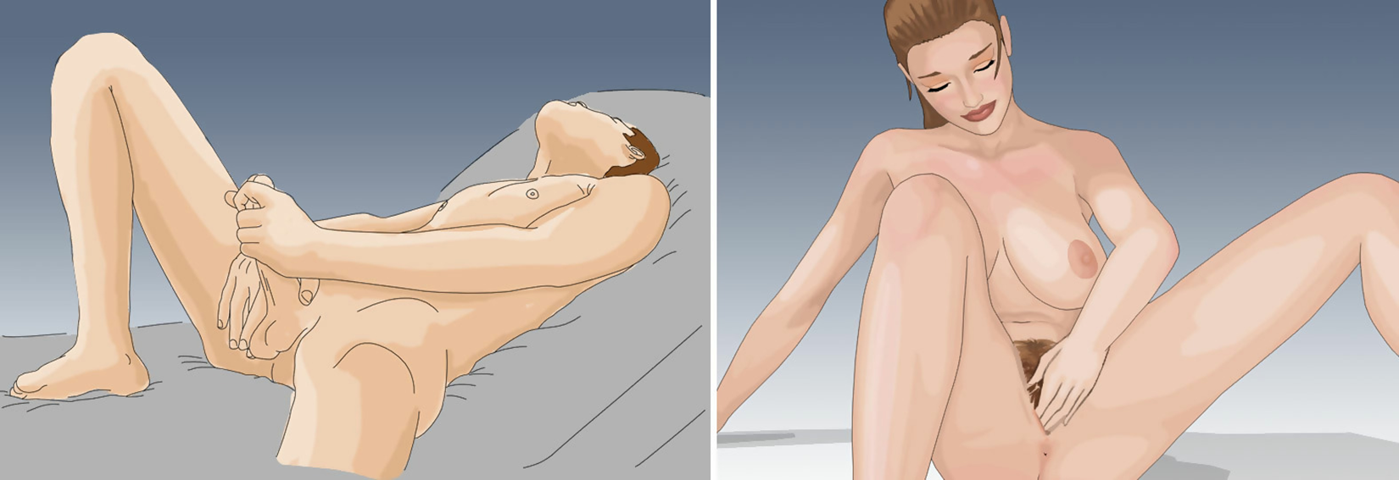
Masturbation
Masturbation: action of touching one’s genitalia or a partner’s genitalia for sexual pleasure.
Generational effects: masturbation rates are not highest among the elderly due to the era in which they were born
Some females and males find they are physically or emotionally uncomfortable if they masturbate without orgasm.
Post-sex dysphoria not associated with any history of trauma.

Slide 12



Lubricants for Masturbation
People who do not use lubricants should take care that they do not chafe delicate genital tissues.
Lubricants can include:
  One’s own body’s spit: safe if individual has no STIs
  Urine
  Hand lotion
  Soap
  Food: BUT, if it contains sugar it can cause yeast infection in females
  Lubricant designed for sexual pleasure

Slide 13
Variety is Recommended
Masturbation is helpful:
  For learning the sensations associated with arousal and orgasm.
  In allowing a person to modulate sexual response with a partner.
Training in masturbation and learning to control orgasm through practice is a main technique of sex therapy:
  For people for whom orgasm occurs too soon or does not occur.

Slide 14
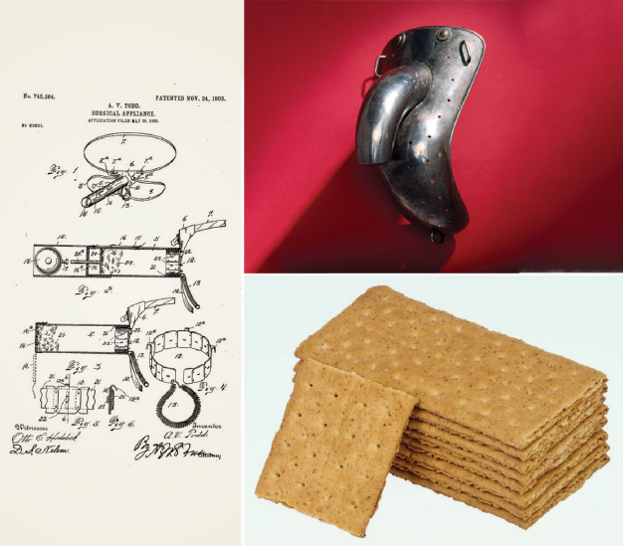
Anti-Masturbation Inventions of Earlier Eras

Slide 15
Masturbation, Sodomy, and Celibacy
Some religions have viewed masturbation to be a sin:
  Sex education does not figure prominently in primary and secondary schools.
Sodomy: sexual behavior between people which is non-procreative is viewed as sinful.
Celibacy: deliberate abstinence from sexual relations.
  Can be partial or complete.
  Chosen mainly by people following certain religious orders.

Slide 16

First Partnered Sexual Experiences
In many cultures, a first partnered sexual experience or sexual debut may refer to a specific sexual behavior such as PVI- penis-in-vagina-intercourse.
The term “losing one’s virginity” implies a negative connotation to those who choose to be sexually active.
  It also assumes a cisgender and heteronormative bias.
  Why don’t we say we are no longer a virgin when we experience our first partnered orgasm?

Slide 17

Play video re: the hymen and virginity

Slide 18
Sexual Scripts, Culture, and Frequency of Sex
Sexual script: culturally understood sequence of events in a sexual encounter.
Cultural variations exist in normative sexual behavior.
Frequency of sexual activity and satisfaction in industrialized nations is highly varied.
A 2020 study found that from 2000 to 2018, sexual inactivity increased among U.S. men such that approximately 1 in 3 men aged 18 to 24 years reported no sexual activity in the past year.
Sexual inactivity also increased among men and women aged 25 to 34 years.
Ueda P, Mercer CH, Ghaznavi C, Herbenick D. Trends in Frequency of Sexual Activity and Number of Sexual Partners Among Adults Aged 18 to 44 Years in the US, 2000-2018. JAMA Netw Open. 2020;3(6):e203833. doi:10.1001/jamanetworkopen.2020.3833

Slide 19



Other Differences in Sexual Behavior
Individual factors affect the prevalence of sexual behaviors:
  Age cohort
  Racial and ethnic group membership
  Religiosity
  Sexual orientation

Slide 20
Touching and Kissing
Kissing: touching the lips to any other part of another person’s body, most commonly but not only another person’s lips.
  Deep kissing (French kissing): open-mouthed lip-to-lip contact where people also place their tongues in one another’s mouths.
Can lead to transfer of skin-to-skin viruses such as:
  HSV (herpes, both strains)
  HPV (many strains)
  Hepatitis A
Foreplay: intended to increase arousal and pleasure prior to some other activity (often intercourse).
Afterplay: sexual contact that continues after orgasm.
Spooning: hugging and cuddling, either face-to-face or face-to-back.

Slide 21
Telepathy, Communication, and Faking
Elaborate activities and unfamiliar sexual behaviors benefit from discussing and advanced planning.
Common reasons for faking orgasm:
  Wanting a partner to feel pleased
  Not wanting to hurt a partner’s feelings
  Orgasm appeared unlikely
  Wanting sex to end

Slide 22
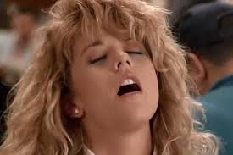
Research Focus
Muehlenhard & Shippee, 2009:
  People who had experienced penile-vaginal intercourse, oral sex, mutual masturbation, and phone sex.
  Both sexes frequently fake orgasms:
    28% of males
    67% of females

Slide 23
Partnered Masturbation and Genital-Body Contact
Mutual masturbation: touching the genitalia of a partner, and involves reciprocation:
  Potential to transmit all STIs.
Genital touch includes rubbing one’s genitalia against parts of a partner’s body.
Tribadism: rubbing the vulva and clitoris against the vulva and clitoris.
Frottage or outercourse: sexual contact through clothing.
Anal touch may be receptive or penetrative, solo or partnered.

Slide 24


Oral-Genital Stimulation
Fellatio: oral-genital contact on a male’s penis.
Cunnilingus: oral-genital contact on a female’s vulva.
Deep throating: causing the penis to extend into a partner’s throat.
Condoms and dental dams help to reduce chances of STIs in oral sex.

Slide 25
Penile-Vaginal Sex / Intercourse
Heterosexual encounter where the male’s penis enters the female’s vagina.
Rear entry: male mounting the female from behind, with the penis entering the vagina.
Face-to-face sex (front entry): male or female face each other, laying abdomen to abdomen or standing.
Missionary position: male laying above a female, supporting his weight with arms or hands.

Slide 26
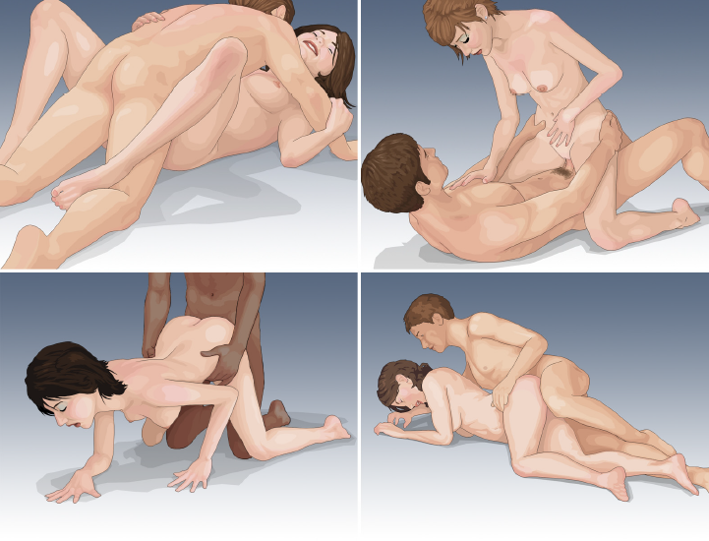
Common Positions for Penile-Vaginal Intercourse

Slide 27
Penile-Vaginal Sex / Intercourse
Intromission: entry of the penis into the vagina.
Many couples pause during intercourse and engage in other types of behavior.
Simultaneous orgasms are rare:
  Couples may prefer to pay attention to their partner’s climax, which they cannot experience if they are climaxing at the same time.
Most females do not regularly experience orgasm from intercourse unless direct clitoral stimulation is involved:
  Some females, if they are above a male, are able to control the timing of thrusts sufficiently well to achieve orgasm.
Vaginismus: painful, muscular contractions of the vaginal walls.
Vaginal rejuvenation: supposedly creating tighter vaginal walls and enhancing perineal support.

Slide 28
The Orgasm Gap
There is a gap between men and women in the frequency of orgasm during partnered sex.
  In a large 2017 study, straight men were the most likely to say they usually or always orgasmed when sexually intimate (95%)
    then, gay men (89%)
    bisexual men (89%)
    lesbian women (86%)
    bisexual women (66%)
    heterosexual women (65%)

Slide 29

Urban Legends and Academic Myths
Penis captivus: myth that a penis can become stuck in a vagina, which may have spread when vaginismus was not well understood.
Myths about sexuality brought about many representative phrases of sexual attitudes.

Slide 30

Awkwardness or Embarrassment in Sex
Media and pornographic portrayals of sexual activities are staged and rarely reflect the reality of sex.
In reality, sex may be awkward, messy, and embarrassing.
Possible for unintentional injury to occur during sex.

Slide 31
Types of Anal Sex and Safety in Anal Sex
Anal sex: multiple types of sexual contact that involve the anus.
Rimming: oral-anal contact.
Pegging: person receiving a dildo into the anus.
Anal sex can be practiced safely but presents special health risks:
  Bacteria from the intestinal tract can be transferred from the anus and cause diarrhea or a urinary tract infection.
Safety techniques for anal sex include:
  Ensuring that any fingers inserted into the anus do not have cuts.
  Taking care not to masturbate or touch the fingers to one’s own genitalia or a partner’s unless they have been washed.
  Latex or polyisoprene barrier such as a dental dam can prevent coming into contact with bacteria during oral-anal sex.

Slide 32

Types of Anal Sex and Safety in Anal Sex
Safe anal sex requires using lubrication and learning how to relax the anal sphincters.
Whether people enjoy anal sex or not is highly variable among individuals.
Fisting: insertion of a hand or forearm into the anus.

Slide 33
Dangerous Sex
Sexual activities that have been associated with high rates of injury:
  Fisting
  Vaginal insufflation, especially during pregnancy: blowing air into the vagina
  Insertion of foreign objects in the rectum
  Penile fractures during any type of sexual activity

Slide 34




Sex Toys
Sex toys: devices or objects used to enhance sexual pleasure.
Dildos: objects for vaginal or anal insertion that may resemble an erect penis.
Butt plugs
Sex dolls: life size dolls that can vary from inflatable balloons to manikins with articulating joints, orifices and appendages.
Cock rings: go around the scrotum and penis, maintaining a longer and stronger erection.

Slide 35

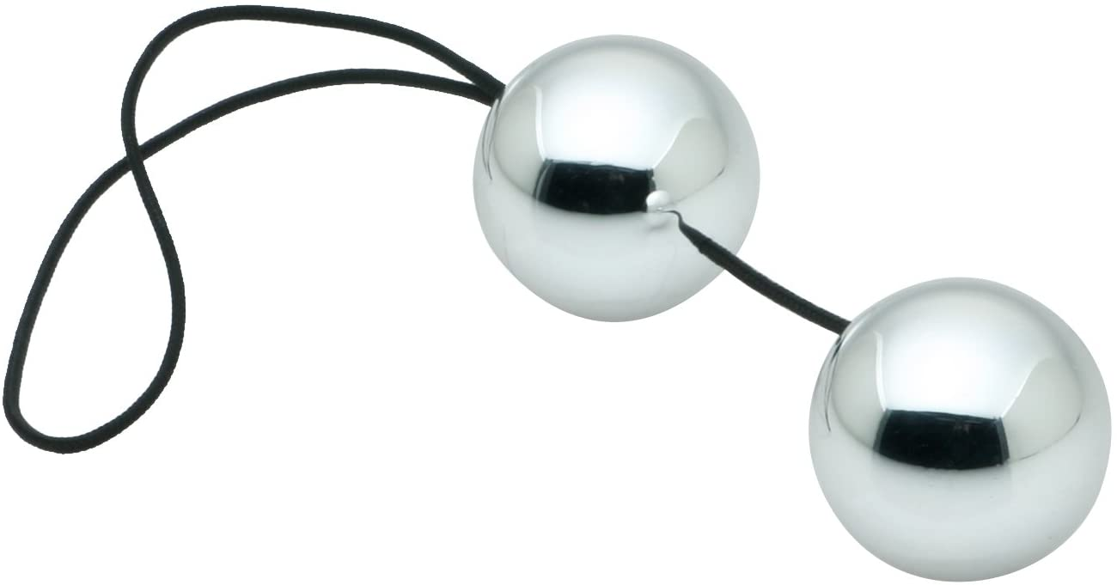


Sex Toys
Masturbation sleeves: produce sensations similar to mucous membranes.
Ben Wa balls: consists of two marble-sized metal balls attached to each other by a string.
Other specialized sex devices:
  Toys for kinks and fetishes
  Fetish clothing, and furniture

Slide 36

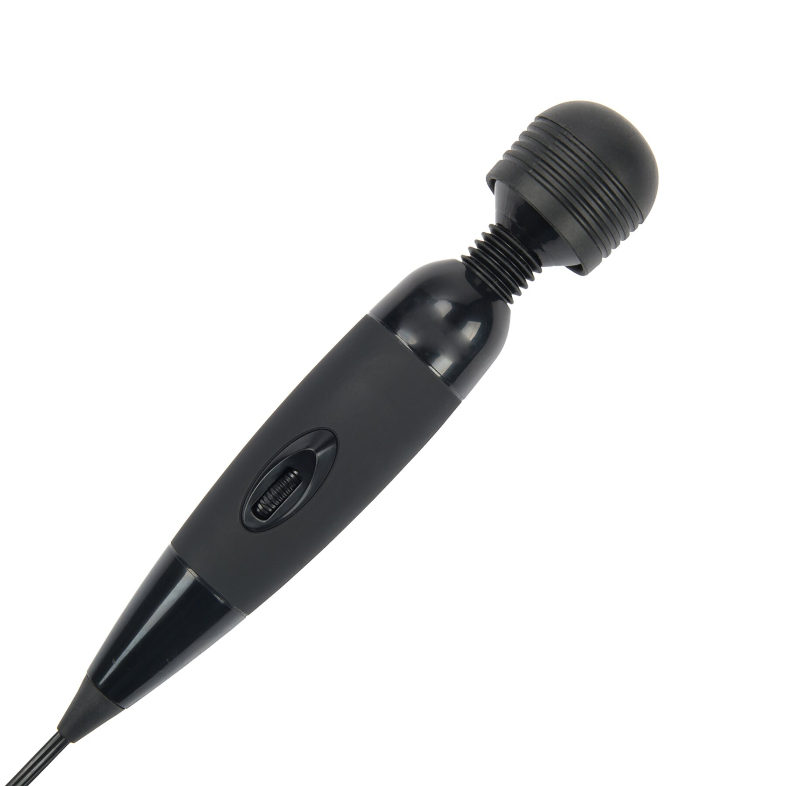
Vibrators: From Medical Masturbation to Sex Toys
Sex toys with an internal vibrating electric motor designed to stimulate the clitoris, prostate, or other tissues for sexual pleasure.
Hysteria: variety of physical and psychological complaints for which no cause was known, that could include weakness, paralysis, headaches, and unhappiness.
  Ancient Greeks used treatment of genital massage, as did Victorian physicians.

Slide 37

Internet Sex and Electronic Media
Electronic media can be a source of erotic stories and erotic images.
Sexting: sending explicit text or instant messages (with or without photographs).

Slide 38
Sex Books
Modern history of sex manuals:
  Kama Sutra: oldest existing sex book
  Kinsey’s factual reports on sexual behavior in the male and female
  Masters and Johnson’s report on human sexual response
  The Joy of Sex
  The Guide to Getting it On
  Specialty sex advice books:
    Instructional videos, along with many websites

Slide 39
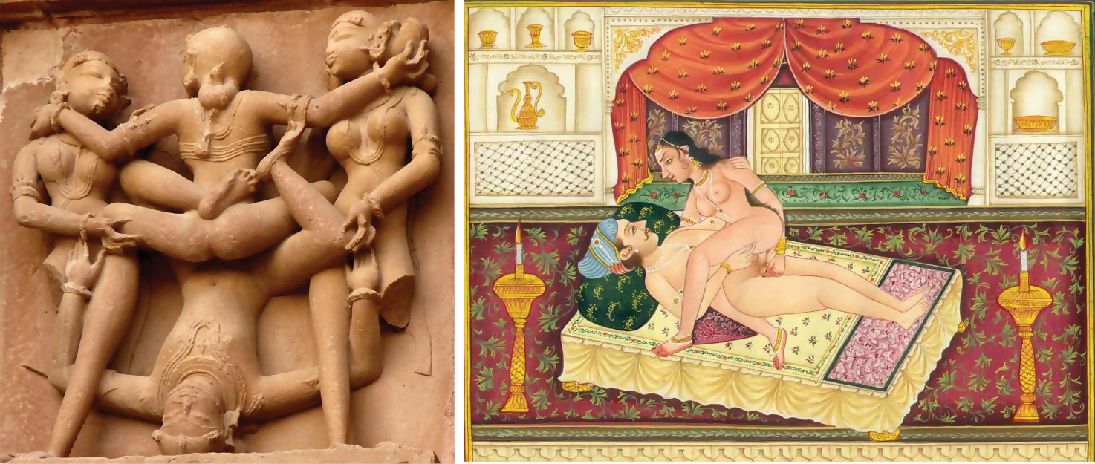
A Position Described in the Kama Sutra and a Hindu Temple

Slide 40
Tantric Sex
Tantric sex constitutes a type of philosophy and a religious tradition with specific rituals and disciplines.
  Emphasizes:
    Quiet meditation and breathing.
    Focusing on spiritual energy, rather than quick release or pleasure.
By delaying orgasm and the male learning how to prevent ejaculation, love making results in spiritually intense, multiple orgasms in both sexes.

Slide 41

Multi-Partner Sexual Behavior
Ménage-a-trois: three-way sex play.
Sex parties (orgies): party where people attend in order to have one or more encounters with varying numbers of people from coupled sex to much larger groups:
  By invitation only
  Organized according to theme
Dogging: where people gather to look for anonymous sexual encounters in couples or small groups.

